Slide 1
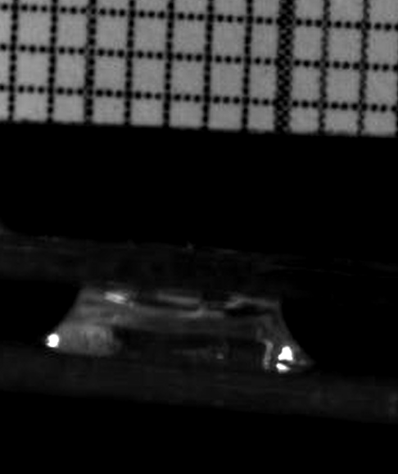
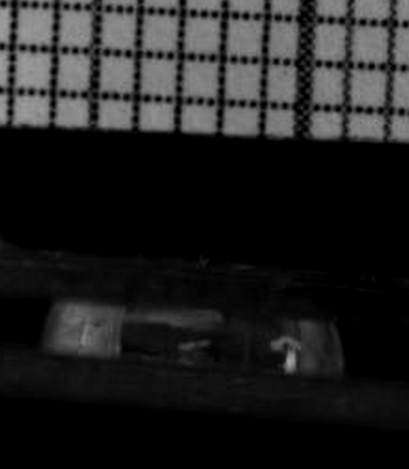
1.0mm to 1.5mm Displacement
Top: 19mm²
Bottom: 38.5mm²
Top: 36mm²
Bottom: 38.5mm²
2017-03-20

Slide 2
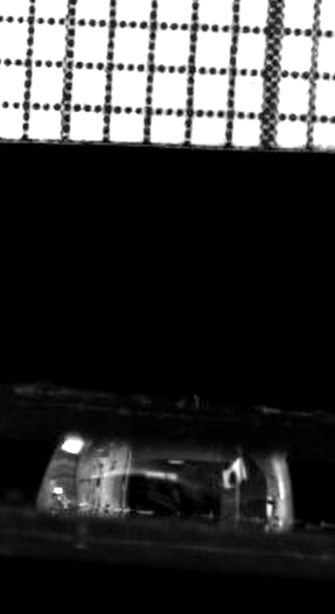
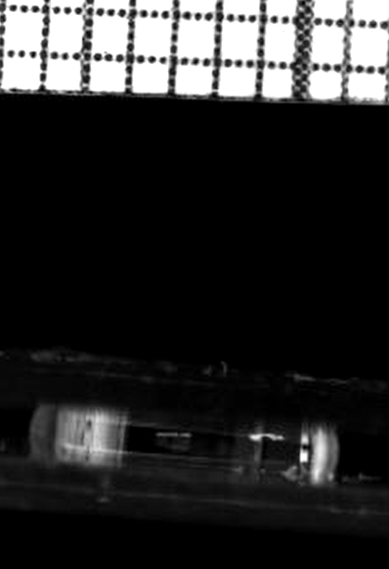
1.0mm to 1.5mm Displacement (Circular Teflon Bottom Electrode)
SAAmp: 6.15mm²
SAOffset: 29.0mm²
Top: 22.9mm²
Bottom: 28.3mm²
Top: 35.2mm²
Bottom: 28.3mm²
2017-03-21

Slide 3
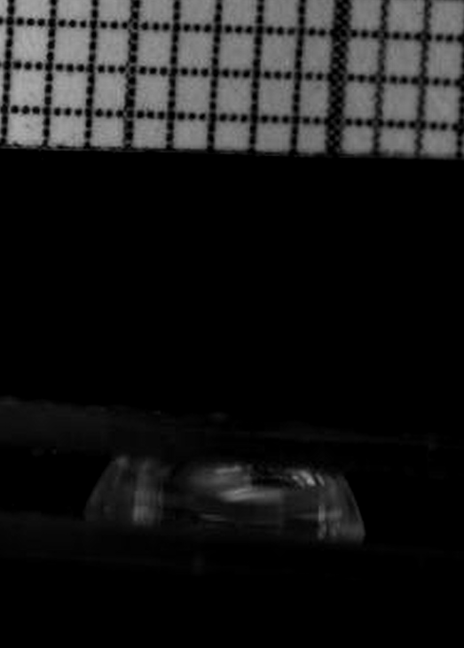
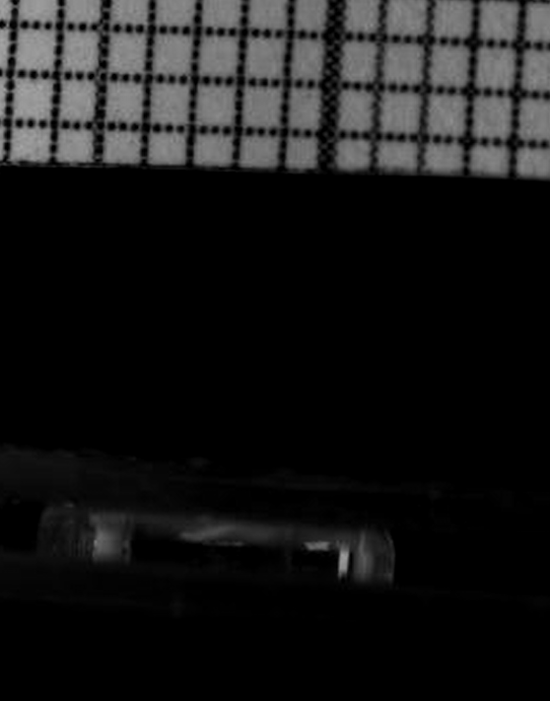
1.0mm to 1.5mm Displacement (Circular Teflon Bottom Electrode)
Top: 21.2mm²
Bottom: 28.3mm²
Top: 40.7mm²
Bottom: 28.3mm²
2017-03-22

Slide 4
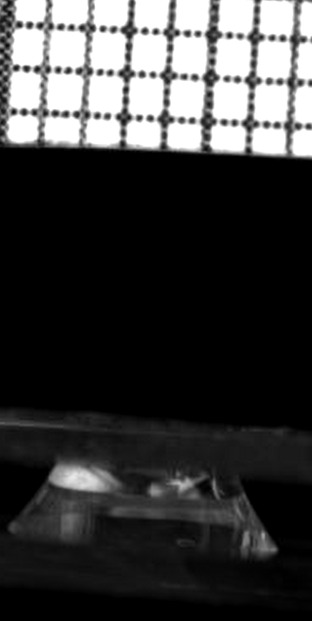
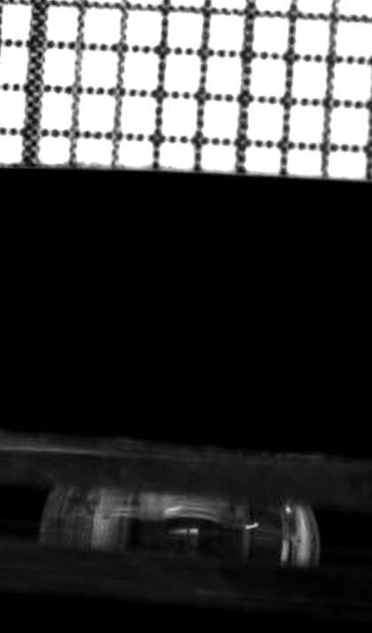
1.0mm to 1.5mm Displacement (Circular Teflon Bottom Electrode)
4.4
dC: 6.55mm²
Caverage: 21.75mm²
Top: 15.2mm²
Bottom: 28.3mm²
Top: 28.3mm²
Bottom: 28.3mm²
2017-03-21

Slide 5
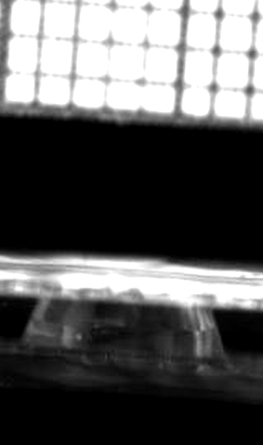
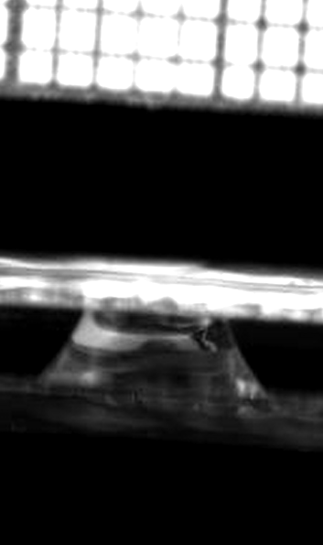
1.0mm to 1.5mm Displacement
SAAmp: 3.2mm²
SAOffset: 20.5mm²
Top: 17.3mm²
Bottom: 30.6mm²
Top: 23.7mm²
Bottom: 28.3mm²
2017-04-21

Slide 6
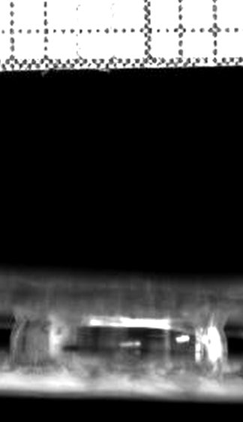
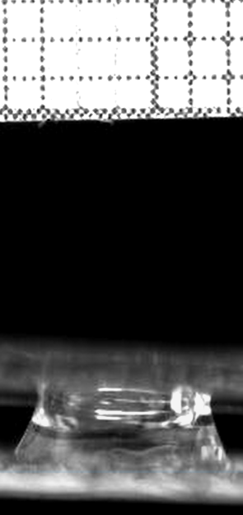
2017-04-25 Old Electrode
1.0mm to 1.5mm Displacement
SAAmp: 5.5mm²
SAOffset: 22.8mm²
Top: 28.3mm²
Top: 17.3mm²

Slide 7
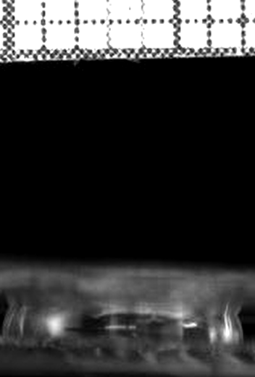
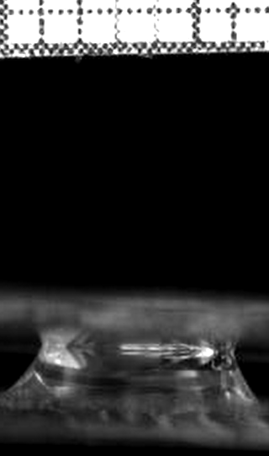
2017-04-27 B
1.0mm to 1.5mm Displacement
SAAmp: 8.9mm²
SAOffset: 28.5mm²
Top: 37.4mm²
Top: 19.6mm²

Slide 8
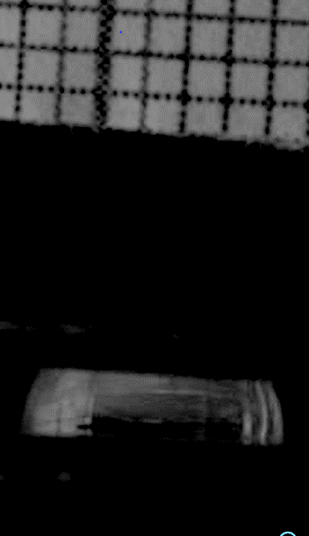
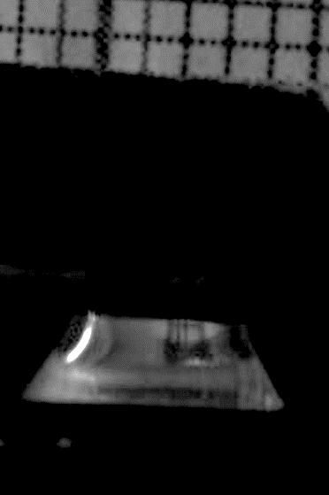
2017-05-21 A
1.5mm to 2.0mm Displacement
SAAmp: 6.5mm²
SAOffset: 17.25mm²
Top: 23.75mm²
Top: 12.6mm²

